Slide 1
Welcome to the
Classification & Regression
Analysis
Classification and Regression

Slide 2

Decision making
Learning Objectives
Function Approximation/estimation
Classification
Regression
Classification vs Regression
Converting Between Classification and Regression Problems

Slide 3
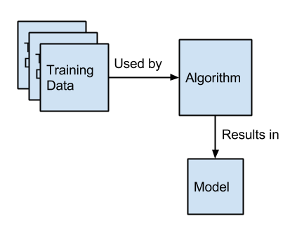
general Scheme

Slide 4
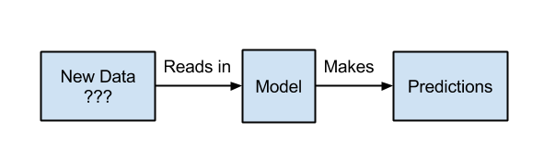
general Scheme

Slide 5
Function Approximation/estimation
Predictive modeling is the problem of developing a model using historical data to make a prediction on new data where we do not have the answer.
Predictive modeling can be described as the mathematical problem of approximating a mapping function (f) from input variables (X) to output variables (y). This is called the problem of function approximation.

Slide 6
Function Approximation/estimation
Goal: The job of the modeling algorithm is to find the best mapping function we can given the time and resources available.
What is f()?
Generally, we can divide all function approximation tasks into classification tasks and regression tasks.

Slide 7
Classification
Classification is the task of approximating a mapping function (f) from input variables (X) to discrete output variables (y).
The output variables are often called labels or categories. The mapping function predicts the class or category for a given observation.

Slide 8
Classification
For example,
an email of text can be classified as belonging to one of two classes: “spam“and “not spam“.

Slide 9
Classification: possible contexts
A classification problem requires that examples be classified into one of two or more classes.
A classification can have real-valued or discrete input variables.
A problem with two classes is often called a two-class or binary classification problem.
A problem with more than two classes is often called a multi-class (multinary) classification problem.
A problem where an example is assigned multiple classes is called a multi-label classification problem.

Slide 10
Classification: methods
Some of the methods commonly used for binary classification are:
Decision trees
Random forests
Bayesian networks
Support vector machines
Neural networks
Logistic regression
Probit model

Slide 11
RANDOM FORESTS

Slide 12
Ensemble methods
A single decision tree does not perform well
But, it is super fast
What if we learn multiple trees?
We need to make sure they do not all just learn the same

Slide 13
Bagging
If we split the data in random different ways, decision trees give different results, high variance.
Bagging: Bootstrap aggregating is a method that result in low variance.
If we had multiple realizations of the data (or multiple samples), we could calculate the predictions multiple times and take the average of the fact that averaging multiple onerous estimations produce less uncertain results

Slide 14
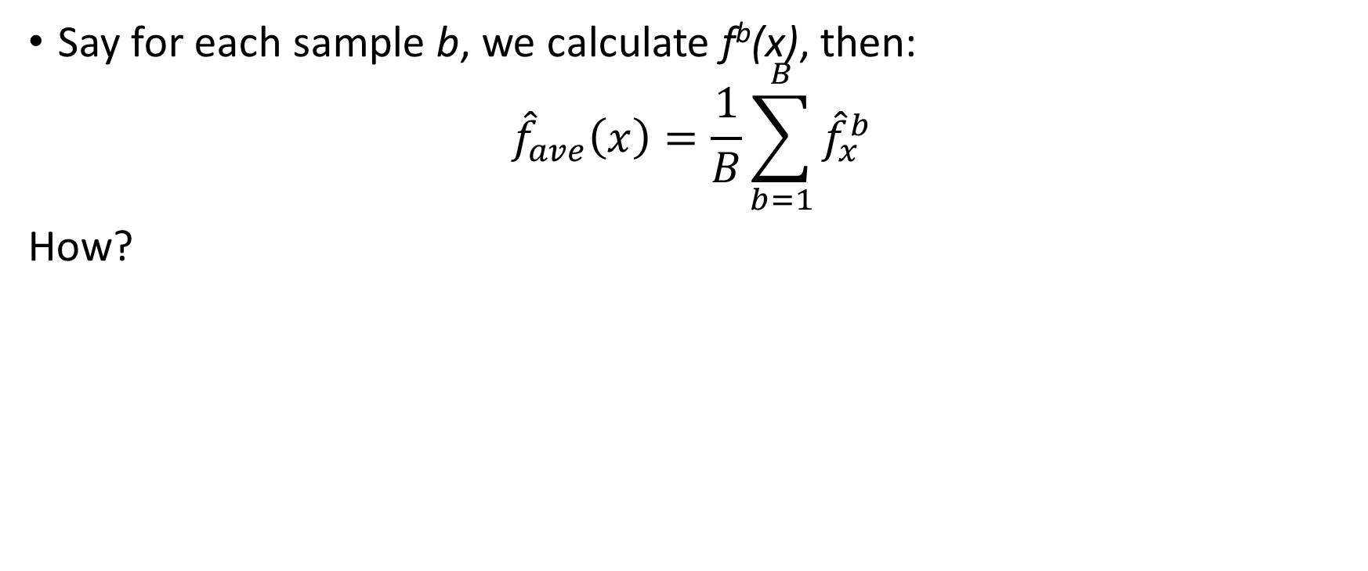
Bagging
Bootstrap

Slide 15
Bootstrap
Construct B (hundreds) of trees (no pruning)
Learn a classifier for each bootstrap sample and average them
Very effective

Slide 16
Bagging for classification: Majority vote

Slide 17
Bagging decision trees

Slide 18
Out‐of‐Bag Error Estimation
No cross validation?
Remember, in bootstrapping we sample with replacement, and therefore not all observations are used for each bootstrap sample. On average 1/3 of them are not used!
We call them out‐of‐bag samples (OOB)
We can predict the response for the i-­th observation using each of the trees in which that observation was OOB and do this for n observations
Calculate overall OOB MSE or classification error

Slide 19
Bagging
Reduces overfitting (variance)
Normally uses one type of classifier
Decision trees are popular
Easy to parallelize

Slide 20
Variable Importance Measures
Bagging results in improved accuracy over prediction using a single tree
Unfortunately, difficult to interpret the resulting model. Bagging improves prediction accuracy at the expense of interpretability.
Calculate the total amount that the RSS or Gini index is decreased due to splits over a given predictor, averaged over all B trees.

Slide 21
Bagging
Each tree is identically distributed (i.d.)
→ the expectation of the average of B such trees is the same as the expectation of any one of them
→ the bias of bagged trees is the same as that of the individual trees
i.d. and not i.i.d

Slide 22
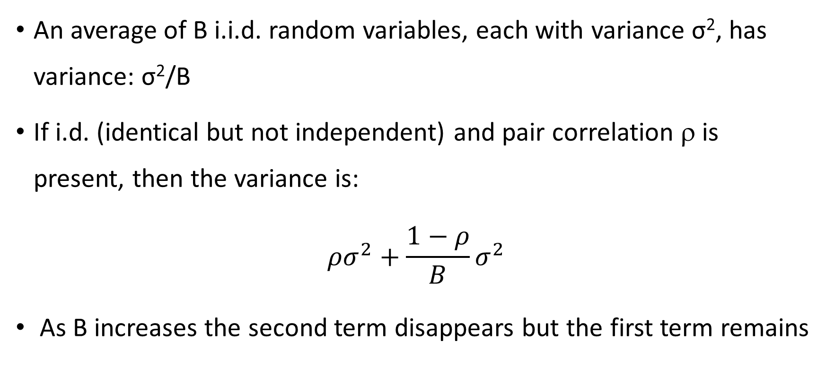
Bagging

Slide 23
Why does bagging generate correlated trees?
Suppose that there is one very strong predictor in the data set, along with a number of other moderately strong predictors.
Then all bagged trees will select the strong predictor at the top of the tree and therefore all trees will look similar.
How do we avoid this?
What if we consider only a subset of the predictors at each split?
We will still get correlated trees unless …. we randomly select the subset !

Slide 24
Random Forest, Ensemble Model
The random forest (Breiman, 2001) is an ensemble approach that can also be thought of as a form of nearest neighbor predictor.
Ensembles are a divide-and-conquer approach used to improve performance. The main principle behind ensemble methods is that a group of “weak learners” can come together to form a “strong learner”.

Slide 25
Trees and Forests
The random forest starts with a standard machine learning technique called a “decision tree” which, in ensemble terms, corresponds to our weak learner. In a decision tree, an input is entered at the top and as it traverses down the tree the data gets bucketed into smaller and smaller sets.

Slide 26
Random Forest
As in bagging, we build a number of decision trees on bootstrapped training samples each time a split in a tree is considered, a random sample of m predictors is chosen as split candidates from the full set of p predictors.
Note that if m = p, then this is bagging.

Slide 27
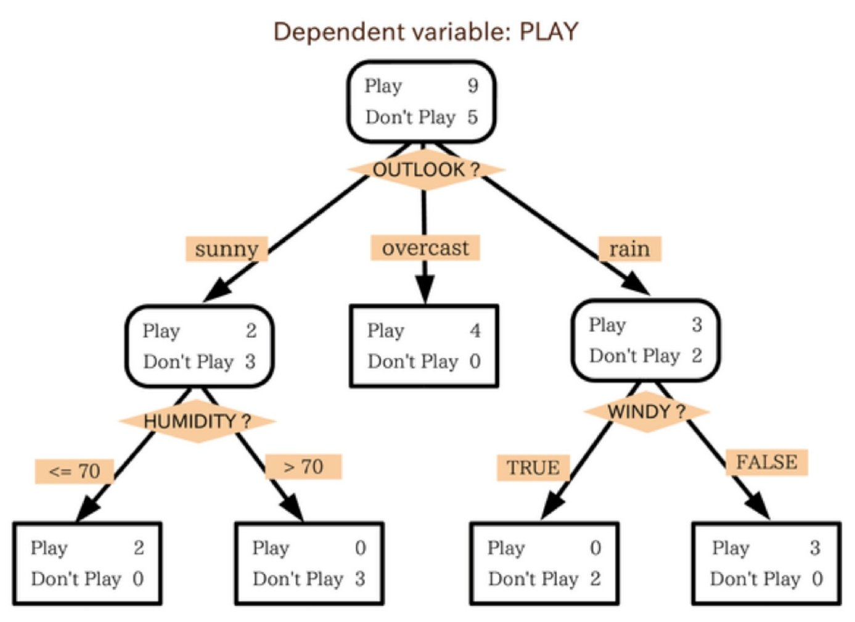
Trees and Forests
In this example, the tree advises us, based upon weather conditions, whether to play ball. For example, if the outlook is sunny and the humidity is less than or equal to 70, then it’s probably OK to play.

Slide 28
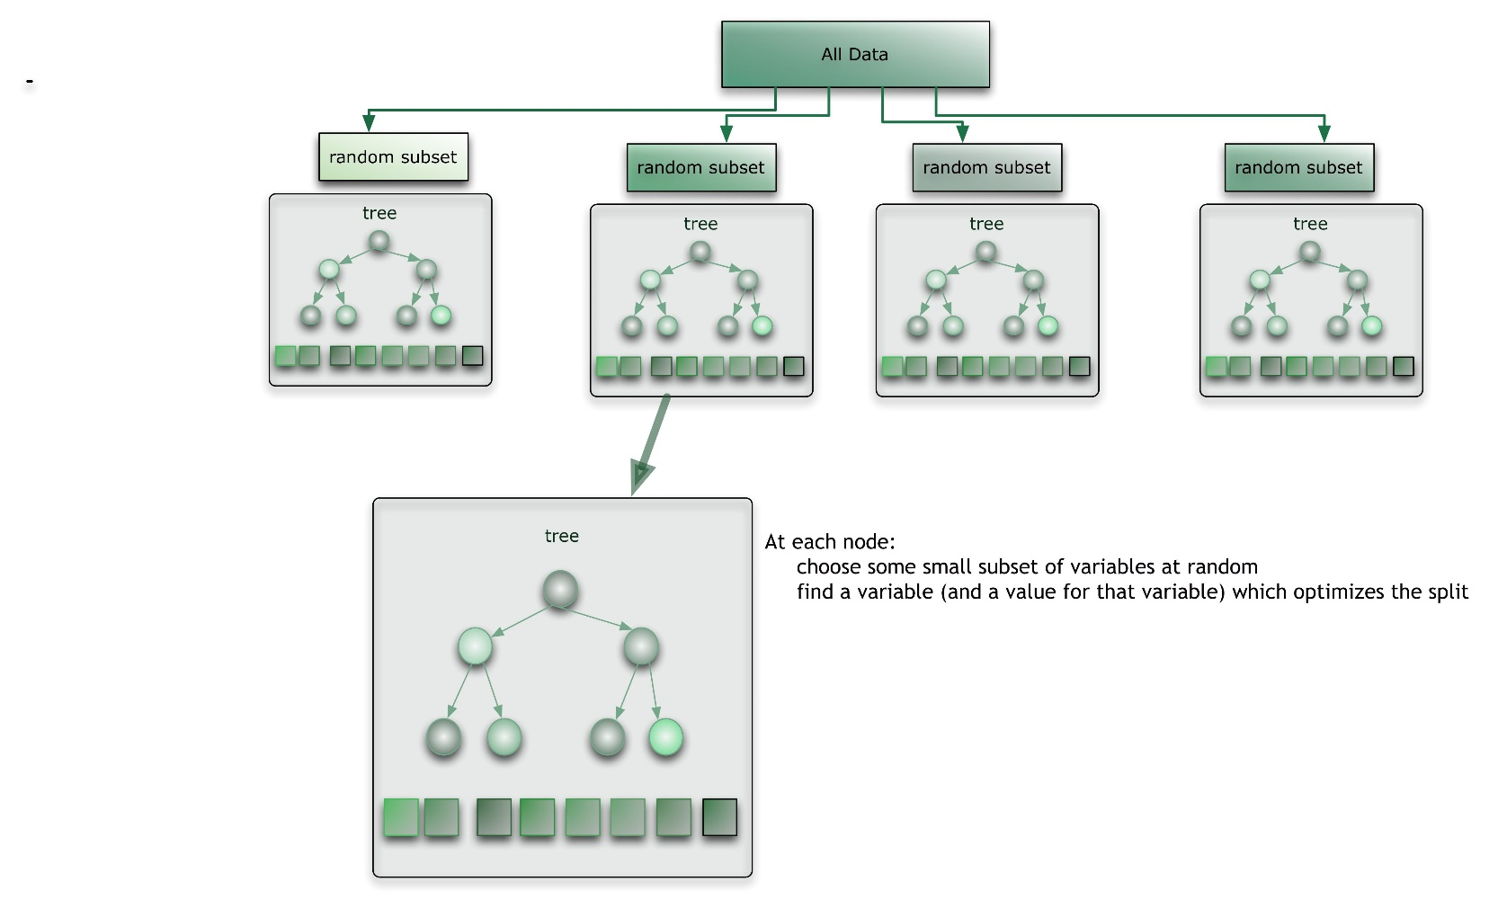
Trees and Forests
The random forest takes this notion to the next level by combining trees with the notion of an ensemble. Thus, in ensemble terms, the trees are weak learners and the random forest is a strong learner.

Slide 29
Random Forest Algorithm
For b = 1 to B:
Draw a bootstrap sample Z∗ of size N from the training data.
(b) Grow a random-forest tree to the bootstrapped data, by recursively repeating the following steps for each terminal node of the tree, until the minimum node size n_{min} is reached.
Select m variables at random from the p variables.
Pick the best variable/split-point among the m.
Split the node into two daughter nodes. Output the ensemble of trees.

Slide 30
Random Forest Algorithm
To make a prediction at a new point x we do:
→ For regression: average the results
→ For classification: majority vote

Slide 32
Training the algorithm
For some number of trees T:
Sample N cases at random with replacement to create a subset of the data. The subset should be about 66% of the total set.
At each node:
For some number m (see below), m predictor variables are selected at random from all the predictor variables.
The predictor variable that provides the best split, according to some objective function, is used to do a binary split on that node.
At the next node, choose another m variables at random from all predictor variables and do the same.
Depending upon the value of m, there are three slightly different systems:
Random splitter selection: m =1
Breiman’s bagger: m = total number of predictor variables
Random forest: m << number of predictor variables. Breiman suggests three possible values for m: ½√m, √m, and 2√m

Slide 33
Running a Random Forest
When a new input is entered into the system, it is run down all of the trees. The result may either be an average or weighted average of all of the terminal nodes that are reached, or, in the case of categorical variables, a voting majority.
Note that:
With a large number of predictors, the eligible predictor set will be quite different from node to node.
The greater the inter-tree correlation, the greater the random forest error rate, so one pressure on the model is to have the trees as uncorrelated as possible.
As m goes down, both inter-tree correlation and the strength of individual trees go down. So some optimal value of m must be discovered.

Slide 34
Differences to standard tree
Train each tree on Bootstrap Resample of data (Bootstrap resample of data set with N samples: Make new data set by drawing with Replacement N samples; i.e., some samples will probably occur multiple times in new data set)
For each split, consider only m randomly selected variables
Don’t prune
Fit B trees in such a way and use average or majority voting to aggregate results

Slide 35
Random Forests Tuning
The inventors make the following recommendations:
→ For classification, the default value for m is √p and the minimum node size is one.
→ For regression, the default value for m is p/3 and the minimum node size is five.
In practice the best values for these parameters will depend on the problem, and they should be treated as tuning parameters.
Like with Bagging, we can use OOB and therefore RF can be fit in one sequence, with cross-validation being performed along the way. Once the OOB error stabilizes, the training can be terminated.

Slide 36
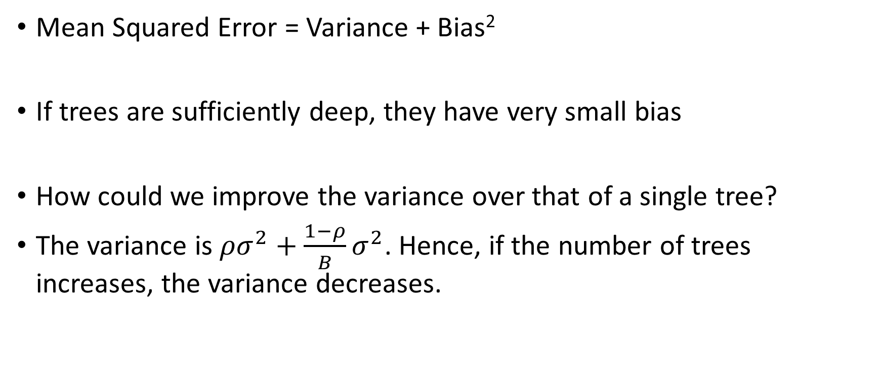
Why Random Forests works:

Slide 37
Advantages of Random Forest
No need for pruning trees
Accuracy and variable importance generated automatically
Overfitting is not a problem
Not very sensitive to outliers in training data
Easy to set parameters
Good performance

Slide 38
Bayesian Networks

Slide 39
Bayesian networks
A simple, graphical notation for conditional independence assertions and hence for compact specification of full joint distributions
Syntax:
a set of nodes, one per variable
a directed, acyclic graph (link ≈ "directly influences")
a conditional distribution for each node given its parents:
P (X_{i} | Parents (X_{i}))
In the simplest case, conditional distribution represented as a conditional probability table (CPT) giving the distribution over X_{i} for each combination of parent values
A node is independent of its nondescendents given its parents.

Slide 40
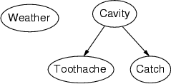
Example
Topology of network encodes conditional independence assertions:
Weather is independent of the other variables
Toothache and Catch are conditionally independent given Cavity

Slide 41
Example
I'm at work, neighbor John calls to say my alarm is ringing, but neighbor Mary doesn't call. Sometimes it's set off by minor earthquakes. Is there a burglar?
Variables: Burglary, Earthquake, Alarm, JohnCalls, MaryCalls
Network topology reflects "causal" knowledge:
A burglar can set the alarm off
An earthquake can set the alarm off
The alarm can cause Mary to call
The alarm can cause John to call

Slide 42
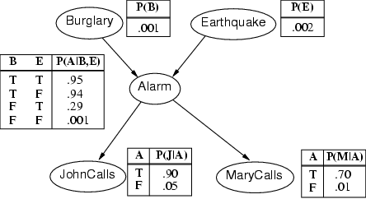
Example contd.

Slide 43
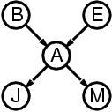
Compactness
A CPT for Boolean X_{i} with k Boolean parents has 2^{k} rows for the combinations of parent values
Each row requires one number p for X_{i} = true (the number for X_{i} = false is just 1-p)
If each variable has no more than k parents, the complete network requires O(n · 2^{k}) numbers
I.e., grows linearly with n, vs. O(2^{n}) for the full joint distribution
For burglary net, 1 + 1 + 4 + 2 + 2 = 10 numbers (vs. 2⁵-1 = 31)

Slide 44
Semantics
The full joint distribution is defined as the product of the local conditional distributions:
P (X₁, … ,X_{n}) = Π_{i = 1} P (X_{i} | Parents(X_{i}))
e.g., P(j ∧ m ∧ a ∧ ¬b ∧ ¬e)
= P (j | a) P (m | a) P (a | ¬b, ¬e) P (¬b) P (¬e)
n
A node is independent of its non-descendents given its parents.

Slide 45
Constructing Bayesian networks
1. Choose an ordering of variables X₁, … ,X_{n}
2. For i = 1 to n
add X_{i} to the network
select parents from X₁, … ,X_{i-1} such that
P (X_{i} | Parents(X_{i})) = P (X_{i} | X₁, ... X_{i-1})
This choice of parents guarantees:
P (X₁, … ,X_{n}) = π_{i =1} P (X_{i} | X₁, … , X_{i-1}) (chain rule)
= π_{i =1}P (X_{i} | Parents(X_{i})) (by construction)
n
n

Slide 46
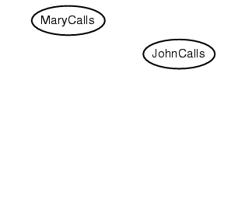
Example
Suppose we choose the ordering M, J, A, B, E
P(J | M) = P(J)?

Slide 47
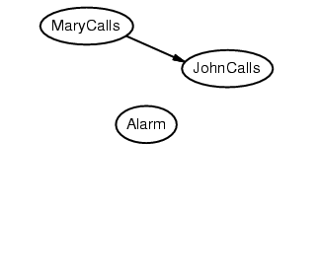
Example
Suppose we choose the ordering M, J, A, B, E
P(J | M) = P(J) No
P(A | J, M) = P(A | J)? P(A | J, M) = P(A)?

Slide 48
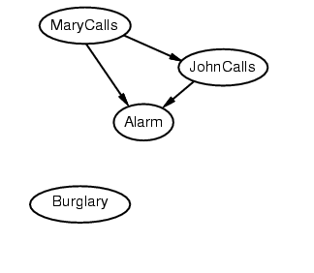
Example
Suppose we choose the ordering M, J, A, B, E
P(J | M) = P(J) No
P(A | J, M) = P(A | J)? P(A | J, M) = P(A)? No
P(B | A, J, M) = P(B | A)?
P(B | A, J, M) = P(B)?

Slide 49
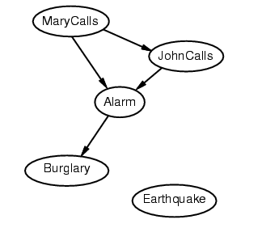
Example
Suppose we choose the ordering M, J, A, B, E
P(J | M) = P(J) No
P(A | J, M) = P(A | J)? P(A | J, M) = P(A)? No
P(B | A, J, M) = P(B | A)? Yes
P(B | A, J, M) = P(B)? No
P(E | B, A ,J, M) = P(E | A)?
P(E | B, A, J, M) = P(E | A, B)?

Slide 50
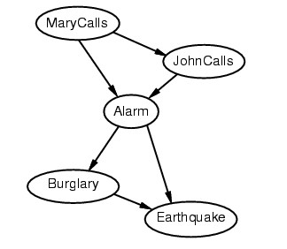
Example
Suppose we choose the ordering M, J, A, B, E
P(J | M) = P(J) No
P(A | J, M) = P(A | J)? P(A | J, M) = P(A)? No
P(B | A, J, M) = P(B | A)? Yes
P(B | A, J, M) = P(B)? No
P(E | B, A ,J, M) = P(E | A)? No
P(E | B, A, J, M) = P(E | A, B)? Yes

Slide 51
Example contd.
Deciding conditional independence is hard in noncausal directions
(Causal models and conditional independence seem hardwired for humans!)
Network is less compact: 1 + 2 + 4 + 2 + 4 = 13 numbers needed

Slide 52
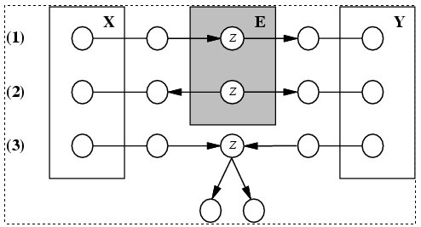
Conditional independence and D-separation
Two sets of nodes, X and Y, are conditionally independent given an evidence set of nodes, E if every undirected path from a node in X to a node in Y is d-seperated by E.
A set of nodes, E d-separates to sets of nodes, X and Y, if every undirected path from a node in X to a node in Y is blocked by E
A path is blocked given E if there is a node Z on the path for which one of the following holds:

Slide 53
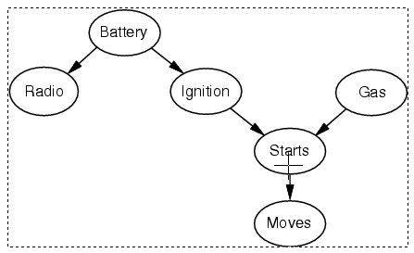
Conditional independence and D-separation - example

Slide 54
Some Applications of BN
Medical diagnosis
Troubleshooting of hardware/software systems
Fraud/uncollectible debt detection
Data mining
Analysis of genetic sequences
Data interpretation, computer vision, image understanding

Slide 55
Support Vector Machines

Slide 56
Getting good generalization on big datasets
If we have a big data set that needs a complicated model, the full Bayesian framework is very computationally expensive.
Is there a frequentist method that is faster but still generalizes well?

Slide 57
Preprocessing the input vectors
Instead of trying to predict the answer directly from the raw inputs we could start by extracting a layer of “features”.
Sensible if we already know that certain combinations of input values would be useful (e.g. edges or corners in an image).
Instead of learning the features we could design them by hand.
The hand-coded features are equivalent to a layer of non-linear neurons that do not need to be learned.
If we use a very big set of features for a two-class problem, the classes will almost certainly be linearly separable.
But surely the linear separator will give poor generalization.

Slide 58
Is preprocessing cheating?
Its cheating if we use a carefully designed set of task-specific, hand-coded features and then claim that the learning algorithm solved the whole problem.
The really hard bit is done by designing the features.
Its not cheating if we learn the non-linear preprocessing.
This makes learning much more difficult and much more interesting (e.g. backpropagation after pre-training)
Its not cheating if we use a very big set of non-linear features that is task-independent.
Support Vector Machines do this.
They have a clever way to prevent overfitting (first half of lecture)
They have a very clever way to use a huge number of features without requiring nearly as much computation as seems to be necessary (second half of lecture).

Slide 59
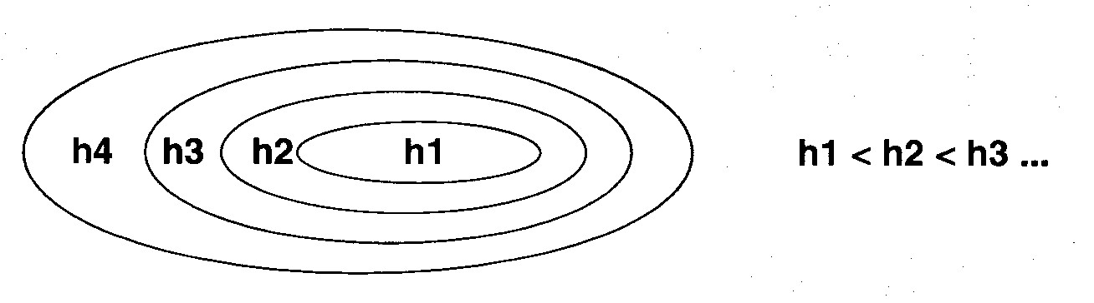
A hierarchy of model classes
Some model classes can be arranged in a hierarchy of increasing complexity.
How do we pick the best level in the hierarchy for modeling a given dataset?

Slide 60
A way to choose a model class
We want to get a low error rate on unseen data.
This is called “structural risk minimization”
It would be really helpful if we could get a guarantee of the following form:
Test error rate =< train error rate + f(N, h, p)
Where N = size of training set,
h = measure of the model complexity,
p = the probability that this bound fails
We need p to allow for really unlucky test sets.
Then we could choose the model complexity that minimizes the bound on the test error rate.

Slide 61
A weird measure of model complexity
Suppose that we pick n datapoints and assign labels of + or – to them at random. If our model class (e.g. a neural net with a certain number of hidden units) is powerful enough to learn any association of labels with the data, its too powerful!
Maybe we can characterize the power of a model class by asking how many datapoints it can “shatter” i.e. learn perfectly for all possible assignments of labels.
This number of datapoints is called the Vapnik-Chervonenkis dimension.
The model does not need to shatter all sets of datapoints of size h. One set is sufficient.
For planes in 3-D, h=4 even though 4 co-planar points cannot be shattered.

Slide 62
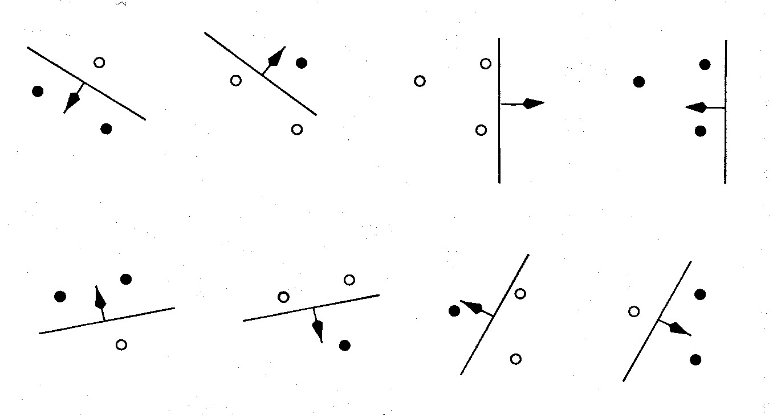
An example of VC dimension
Suppose our model class is a hyperplane.
In 2-D, we can find a plane (i.e. a line) to deal with any labeling of three points. A 2-D hyperplane shatters 3 points
But we cannot deal with some of the possible labelings of four points. A 2-D hyperplane (i.e. a line) does not shatter 4 points.

Slide 63
Some examples of VC dimension
The VC dimension of a hyperplane in 2-D is 3.
In k dimensions it is k+1.
Its just a coincidence that the VC dimension of a hyperplane is almost identical to the number of parameters it takes to define a hyperplane.
A sine wave has infinite VC dimension and only 2 parameters! By choosing the phase and period carefully we can shatter any random collection of one-dimensional datapoints (except for nasty special cases).

Slide 64
The probabilistic guarantee
where N = size of training set
h = VC dimension of the model class
p = upper bound on probability that this bound fails
So if we train models with different complexity, we should pick the one that minimizes this bound
Actually, this is only sensible if we think the bound is fairly tight, which it usually isn’t. The theory provides insight, but in practice we still need some witchcraft.

Slide 65
Preventing overfitting when using big sets of features
Suppose we use a big set of features to ensure that the two classes are linearly separable. What is the best separating line to use?
The Bayesian answer is to use them all (including ones that do not quite separate the data.)
Weight each line by its posterior probability (i.e. by a combination of how well it fits the data and how well it fits the prior).
Is there an efficient way to approximate the correct Bayesian answer?

Slide 66
Support Vector Machines
The line that maximizes the minimum margin is a good bet.
The model class of “hyper-planes with a margin of m” has a low VC dimension if m is big.
This maximum-margin separator is determined by a subset of the datapoints.
Datapoints in this subset are called “support vectors”.
It will be useful computationally if only a small fraction of the datapoints are support vectors, because we use the support vectors to decide which side of the separator a test case is on.
The support vectors are indicated by the circles around them.

Slide 67
Training a linear SVM
To find the maximum margin separator, we have to solve the following optimization problem:
This is tricky but it’s a convex problem. There is only one optimum and we can find it without fiddling with learning rates or weight decay or early stopping.
Don’t worry about the optimization problem. It has been solved. Its called quadratic programming.
It takes time proportional to N^2 which is really bad for very big datasets
so for big datasets we end up doing approximate optimization!

Slide 68
Testing a linear SVM
The separator is defined as the set of points for which:

Slide 69
Neural Networks

Slide 70
Overview
Relation to Biological Brain: Biological Neural Network
The Artificial Neuron
Types of Networks and Learning Techniques
Supervised Learning & Backpropagation Training Algorithm
Learning by Example
Applications
Questions

Slide 71
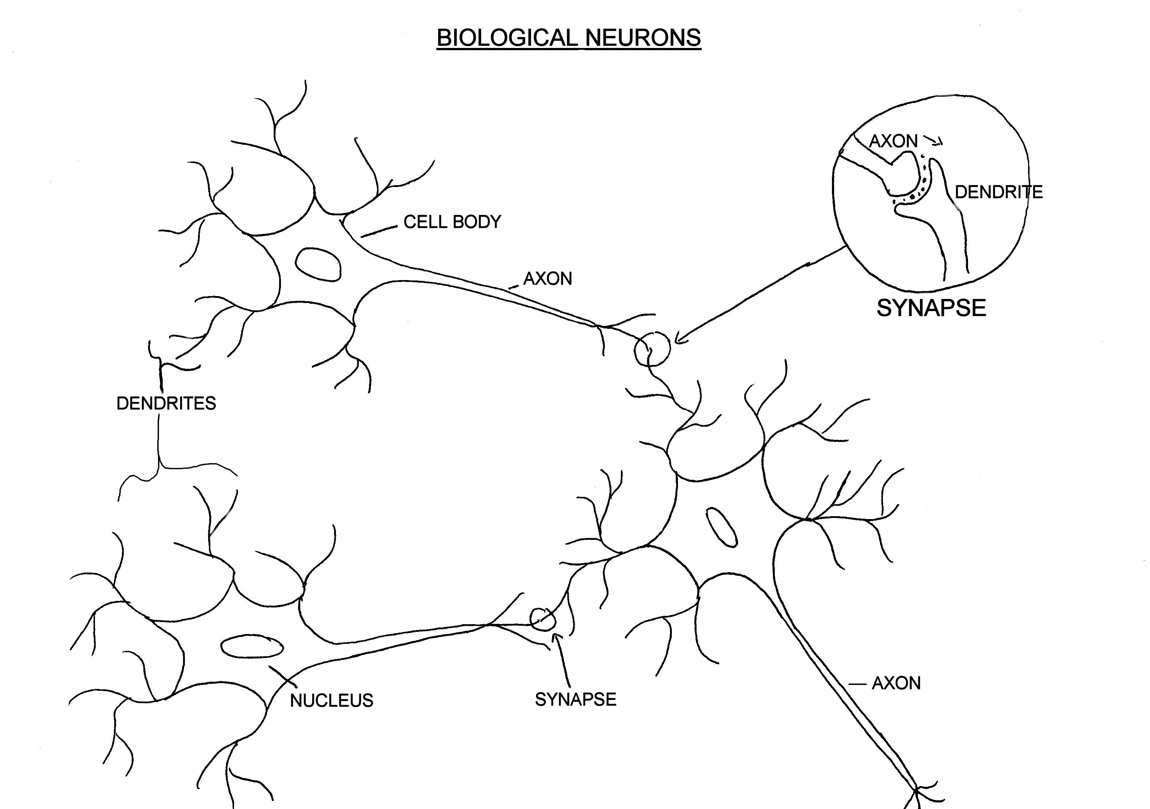
Biological Neuron

Slide 72
Artificial Neuron
W
Neuron
INPUTS
W
Σ
f(n)
Outputs
W
Activation
Function
W
W=Weight

Slide 73
Transfer Functions
1
Output
0
Input

Slide 74
Types of networks
Multiple Inputs and Single Layer
Multiple Inputs and layers

Slide 75
Types of Networks – Contd.
Feedback
Recurrent Networks

Slide 76
Learning Techniques
Supervised Learning:
Expected Output
Inputs from the environment
Actual System
Actual Output
+
Neural Network
Σ
-
Training
Error

Slide 77
Multilayer Perceptron
Output Layer
Inputs
First Hidden layer
Second Hidden Layer

Slide 78
Signal Flow Backpropagation of Errors
Function Signals
Error Signals

Slide 79
Learning by Example
Hidden layer transfer function: Sigmoid function = F(n)= 1/(1+exp(-n)), where n is the net input to the neuron.
Derivative= F’(n) = (output of the neuron)(1-output of the neuron) : Slope of the transfer function.
Output layer transfer function: Linear function= F(n)=n; Output=Input to the neuron
Derivative= F’(n)= 1

Slide 80
Learning by Example
Training Algorithm: backpropagation of errors using gradient descent training.
Colors:
Red: Current weights
Orange: Updated weights
Black boxes: Inputs and outputs to a neuron
Blue: Sensitivities at each layer

Slide 81
First Pass
G1= (0.6225)(1-0.6225)(0.0397)(0.5)(2)=0.0093
G2= (0.6508)(1-0.6508)(0.3492)(0.5)=0.0397
0.6225
0.6225
0.6508
0.5
0.5
0.5
0.6508
0.5
1
0.5
0.5
0.5
0.5
0.6508
0.5
0.6225
0.5
0.6225
0.6508
Gradient of the neuron= G =slope of the transfer function×[Σ{(weight of the neuron to the next neuron) × (output of the neuron)}]
Gradient of the output neuron = slope of the transfer function × error
G3=(1)(0.3492)=0.3492
Error=1-0.6508=0.3492

Slide 82
Weight Update 1
New Weight=Old Weight + {(learning rate)(gradient)(prior output)}
0.5+(0.5)(0.0397)(0.6225)
0.5+(0.5)(0.3492)(0.6508)
0.5+(0.5)(0.0093)(1)
0.5124
0.5047
0.6136
0.5124
0.5124
0.5047
0.6136
0.5124

Slide 83
Second Pass
G1= (0.6236)(1-0.6236)(0.5124)(0.0273)(2)=0.0066
G2= (0.6545)(1-0.6545)(0.1967)(0.6136)=0.0273
0.6236
0.6391
0.6545
0.5047
0.5124
0.6136
0.8033
0.5047
1
0.5124
0.5124
0.5047
0.6136
0.8033
0.5047
0.5124
0.6236
0.6391
0.6545
G3=(1)(0.1967)=0.1967
Error=1-0.8033=0.1967

Slide 84
Weight Update 2
New Weight=Old Weight + {(learning rate)(gradient)(prior output)}
0.5124+(0.5)(0.0273)(0.6236)
0.6136+(0.5)(0.1967)(0.6545)
0.5047+(0.5)(0.0066)(1)
0.5209
0.508
0.6779
0.5209
0.5209
0.508
0.6779
0.5209

Slide 85
Third Pass
0.6243
0.6504
0.508
0.6571
0.5209
0.6779
0.8909
0.508
1
0.5209
0.5209
0.508
0.6779
0.508
0.5209
0.6571
0.8909
0.6243
0.6504

Slide 86
Weight Update Summary
W1: Weights from the input to the input layer
W2: Weights from the input layer to the hidden layer
W3: Weights from the hidden layer to the output layer

Slide 87
Training Algorithm
The process of feedforward and backpropagation continues until the required mean squared error has been reached.
Typical mse: 1e-5
Other complicated backpropagation training algorithms also available.

Slide 88
Why Gradient?
O1
Output
1
W1
O3 = 1/[1+exp(-N)]
W2
N = (O1×W1)+(O2×W2)
Error = Actual Output – O3
O2
O = Output of the neuron
W = Weight
N = Net input to the neuron
0
Input
To reduce error: Change in weights:
Learning rate
Rate of change of error w.r.t rate of change of weight
Gradient: rate of change of error w.r.t rate of change of ‘N’
Prior output (O1 and O2)

Slide 89
Gradient in Detail
Gradient : Rate of change of error w.r.t rate of change in net input to neuron
For output neurons
Slope of the transfer function × error
For hidden neurons : A bit complicated ! : error fed back in terms of gradient of successive neurons
Slope of the transfer function × [Σ (gradient of next neuron × weight connecting the neuron to the next neuron)]
Why summation? Share the responsibility!!
Therefore: Credit Assignment Problem

Slide 90
An Example
G1=0.66×(1-0.66)×(0.34)= 0.0763
1
0.731
0.6645
0.66
1
0.5
Error = 1-0.66 = 0.34
0.5
0.5
0.4
0.5
0.6645
0.66
0
0.598
Error = 0-0.66 = -0.66
Reduce more
G1=0.66×(1-0.66)×(-0.66)= -0.148
Increase less

Slide 91
Improving performance
Changing the number of layers and number of neurons in each layer.
Variation in Transfer functions.
Changing the learning rate.
Training for longer times.
Type of pre-processing and post-processing.

Slide 92
Applications
Used in complex function approximations, feature extraction & classification, and optimization & control problems
Applicability in all areas of science and technology.

Slide 93
Regression

Slide 94
Regression
Regression is the task of approximating a mapping function (f) from input variables (X) to a continuous output variable (y).
A continuous output variable is a real-value, such as an integer or floating point value. These are often quantities, such as amounts and sizes.

Slide 95
Regression: possible contexts
A regression problem requires the prediction of a quantity.
A regression can have real valued or discrete input variables.
A problem with multiple input variables is often called a multiple regression problem.
A regression problem where input variables are the history of output variable throughout time is called a time series analysis problem.

Slide 96
Regression: Measure of performance
Because a regression predictive model predicts a quantity, the skill of the model must be reported as an error in those predictions.
mean squared error

Slide 97
Classification vs Regression
Classification is the task of predicting a discrete output variable.
Regression is the task of predicting a continuous output variable.

Slide 98
Classification vs Regression
Some algorithms can be used for both classification and regression with small modifications,
such as
decision trees
artificial neural networks
Some algorithms cannot, or cannot easily be used for both problem types, such as
linear regression for regression predictive modelling.
logistic regression for classification predictive modeling.

Slide 99
Classification vs Regression: measure of performance
Classification can be evaluated using accuracy, whereas regression predictions cannot. i.e. using confusion matrix
Regression predictions can be evaluated using mean squared error, whereas classification predictions cannot.

Slide 100
Classification—A Two-Step Process
Model construction: describing a set of predetermined classes
Each tuple/sample is assumed to belong to a predefined class, as determined by the class label attribute
The set of tuples used for model construction is training set
The model is represented as classification rules, decision trees, or mathematical formulae
Model usage: for classifying future or unknown objects
Estimate accuracy of the model
The known label of test sample is compared with the classified result from the model
Accuracy rate is the percentage of test set samples that are correctly classified by the model
Test set is independent of training set (otherwise overfitting)
If the accuracy is acceptable, use the model to classify new data

Slide 101
Process (1): Model Construction
Classification
Algorithms
Training
Data
Classifier
(Model)
IF rank = ‘professor’
OR years > 6
THEN tenured = ‘yes’

Slide 102
Process (2): Using the Model in Prediction
Classifier
Testing
Data
Unseen Data
(Jeff, Professor, 4)
Tenured?

